Slide 1
iSAQB® CPSA-F® Examination Guide for iSAQB Accredited Trainers
Based on the CPSA-F Examination Rules 2020
Refers to V 5.0 of the CPSA-F curriculum
Name of the presenter
Date
Notes:
1

Slide 2
Copyright Notice
© (Copyright), International Software Architecture Qualification Board e.V. (iSAQB® e.V.) 2020
This Guide may only be used subject to the conditions stated in the iSAQB Foundation Level Curriculum, especially:
If you are a trainer or training provider, it shall be possible for you to use the documents and/or curricula once you have obtained a usage license. Please address any enquiries to info@isaqb.org.
The International Software Architecture Qualification Board e. V. (iSAQB e.V.) has exclusive entitlement to these copyrights. The abbreviation "e.V." is part of the iSAQB’s official name and stands for registered association, which describes its status as a legal entity according to German law. For the purpose of simplicity, iSAQB e.V. shall hereafter be referred to as iSAQB without the use of said abbreviation.
(C) iSAQB e.V.
Notes:
2

Slide 3
About this Guide
This Guide adds information to the examination rules as published by iSAQB.
This guide only provides explanation – and does NOT replace or overrule the official examination rules.
The official examination rules have precedence over everything stated here.
(C) iSAQB e.V.
Notes:
3

Slide 4
The Curriculum
The curriculum standardizes the contents and their relative priorities
for all Accredited CPSA-F Trainings.
iSAQB Accredited Trainers must know and understand the curriculum,
especially all R1 and R2 learning goals.
Individuals who want to obtain the CPSA-F certificate should read
through it.
The learning goals listed in the curriculum are grouped into chapters
and detailed with learning items.
The curriculum informs about the relevance of learning goals and
learning items with respect to the examination.
(C) iSAQB e.V.
Notes:
4

Slide 5
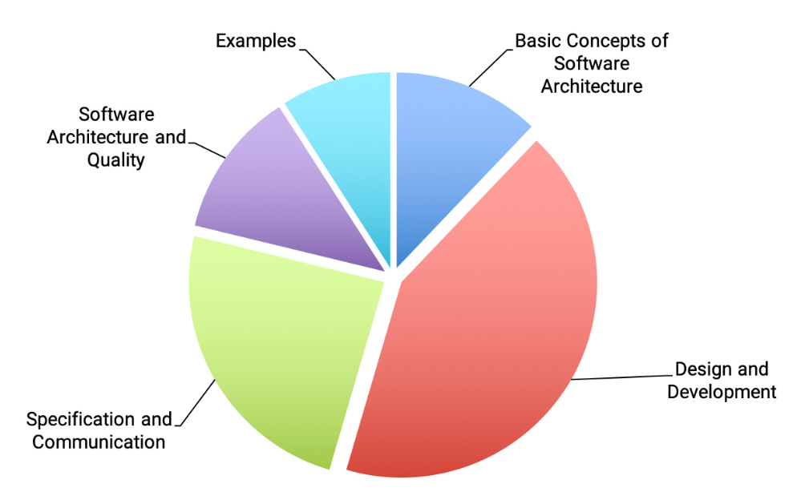
Structure and Relative Size in the iSAQB® Foundation Level Curriculum
The sizes of segments indicate the relative proposed duration of the topics in CPSA-F trainings.
(C) iSAQB e.V.
Notes:
5

Slide 6
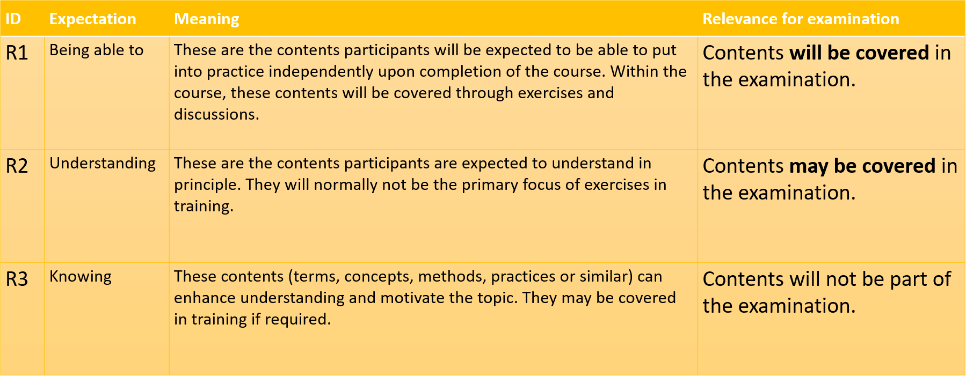
Explanation of Relevance Levels
(C) iSAQB e.V.
Notes:
6

Slide 7
Formalities of CPSA-F® Examination
Required: Passport or any other official document with participants name and image on it. Will be checked by examination provider.
Multiple Choice:
75 min (plus 15 min extra, if examination taken in foreign language)
About 45 questions – depending on the exam sheet you‘ll get
Each question has max 1-3 points
At least 60% of the achievable points required for passing
During examination:
No mobile devices
No printed/written material
No talk about examination topics
(C) iSAQB e.V.
Notes:
7

Slide 8
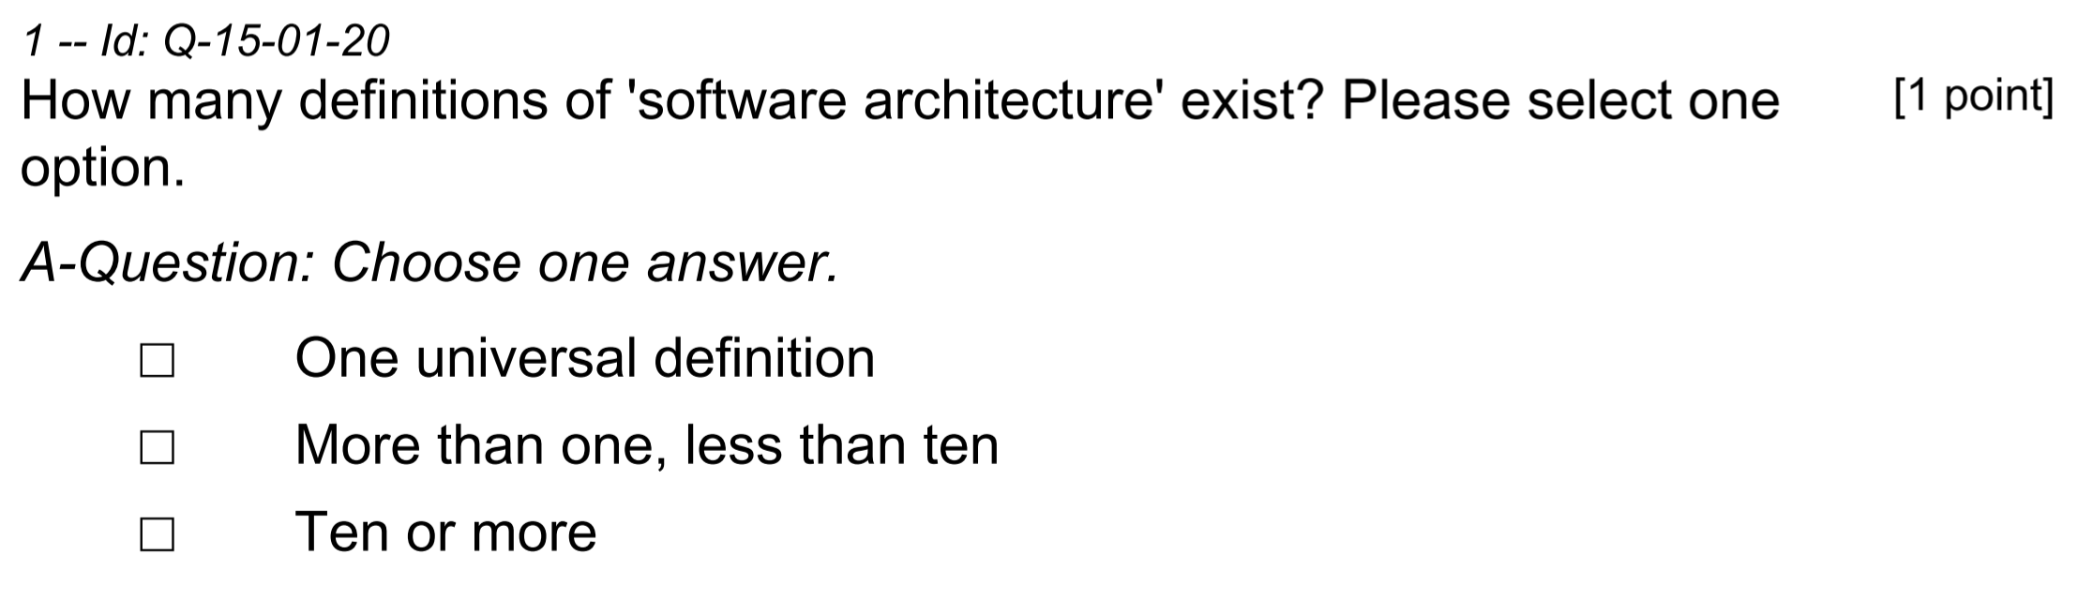
The Structure of Examination Questions
Max. points for
this question
Question No. & ID
Question
Type of question: Selection,
Pick Multiple, Categorize
The options you have to choose from according
to the type of the question.
(C) iSAQB e.V.
Notes:
8

Slide 9
S-Questions (Single Correct Answer)
S-Question:
The correct choice: 1 point
Wrong or too many chosen: 0 points
(C) iSAQB e.V.
Notes:
9

Slide 10
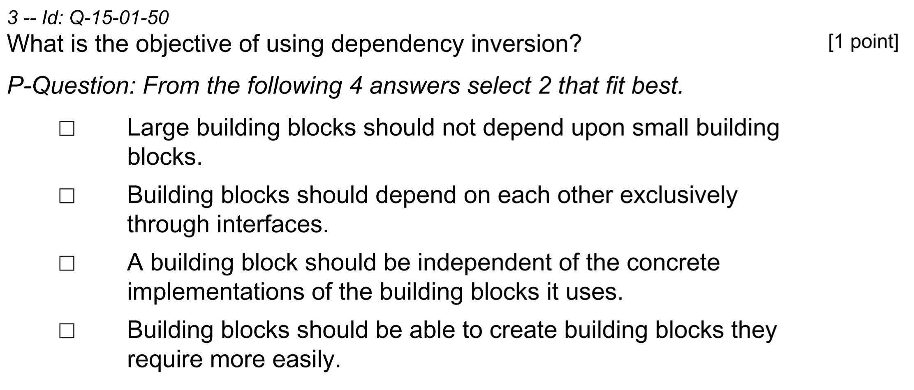
P-Questions (Pick Multiple)
Never select more options than asked for, as that results in zero (0) points.
Each correct answer adds one nth of the total points.
Each wrong answer subtracts one nth of the points.
Giving fewer answers does not lead to deduction.
The worst case is zero points for a question.
only one correct answer given: 0.5 points
two correct answers: 1 point
two wrong answers: 0 points
one wrong answer: 0 points
(C) iSAQB e.V.
Notes:
10

Slide 11
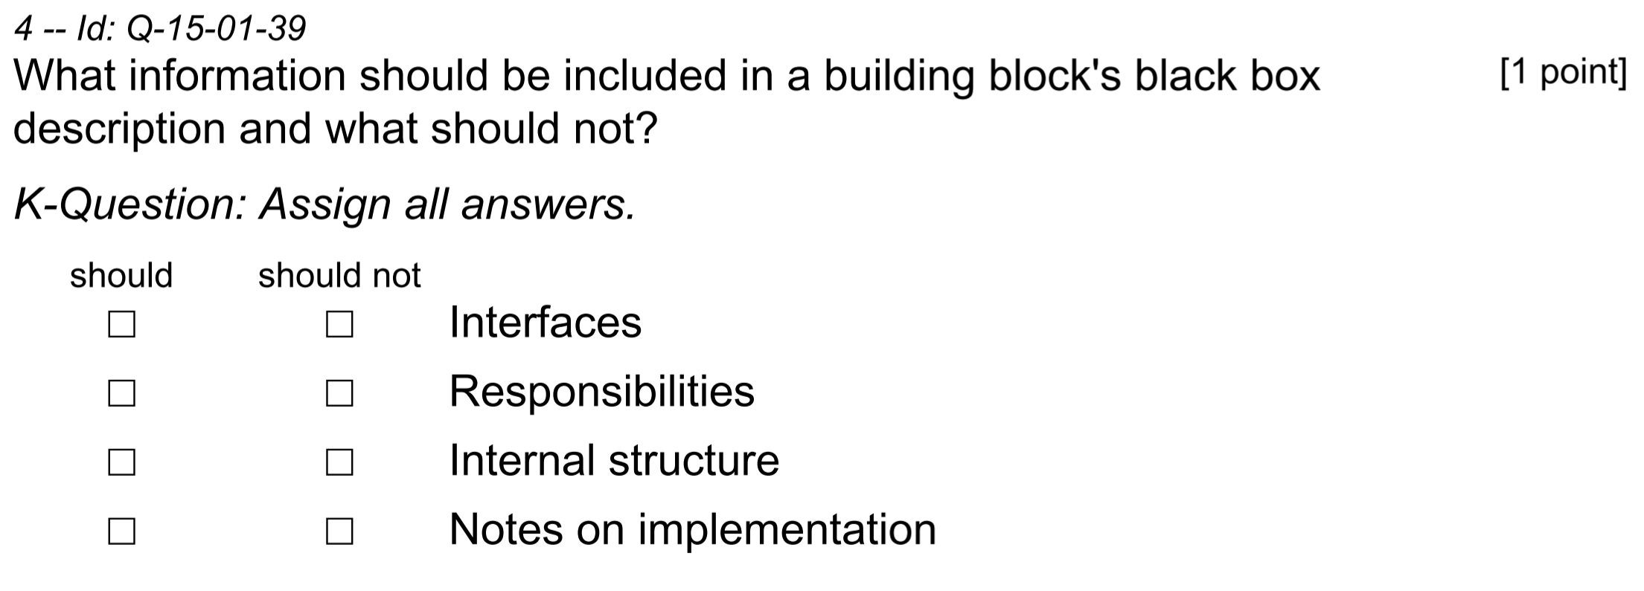
C-Questions (Choose Category)
Mark none or just one option per row.
No mark in a row counts neutral.
Each correct mark adds one nth of the points.
Each wrong mark subtracts one nth of the points.
The worst case is zero points for a question.
C-
There are always exactly 2 mutual exclusive categories.
(C) iSAQB e.V.
Notes:
11

Slide 12
Thank you for your interest!
If you have any questions, please contact info@isaqb.org and ask for the Foundation Level Working Group (FLWG).
Remarks or questions concerning specific learning goals can be left in our public Github repository, where the FLWG maintains the curriculum:
https://github.com/isaqb-org/curriculum-foundation.
You may open an issue in our public issue tracker:
https://github.com/isaqb-org/curriculum-foundation/issues.
(C) iSAQB e.V.
Notes:
12

